Slide 1
The Military Exposures Research Program Rudolph Johnson, Ph.D. Director

Slide 2
MERP Introduction
Who, What, How
Who does MERP help?
Millions of Veterans have encountered toxic agents. Lack of a nexus between exposure and health outcome(s) has been a barrier for Veterans to become eligible for VA care and disability benefits.
What is MERP?
Military Exposures Research Program (MERP) is an Actively Managed Portfolio (AMP) that was created to centralize management of and improve access to all VA Veteran Exposure research.
How is MERP going to help?
MERP will generate high-quality evidence through military exposures research using Core’s, VA internal partnerships, and inter-agency coordination. MERP will utilize peer-reviewed research, ORD research enterprise resources, and PACT Act resources and collaboration opportunities.

Slide 3
PACT Act

Slide 4
PACT Act (1 of 4)
What is the PACT Act?
The PACT Act is the largest health and benefit expansions in American history
On August 10, 2022, the President signed into law the Sergeant First Class Heath Robinson Honoring Our Promise to Address Comprehensive Toxics (PACT) Act of 2022.
It recognizes toxic exposure as a cost of war by addressing the full range of issues impacting toxic-exposed Veterans, ensuring generations of Veterans who suffer from toxic exposure-related conditions get the benefits and care they’ve earned.
To assist in addressing these issues the PACT Act included the creation of the Toxic Exposure Fund.
Notes:
NOT FINISHED EDITING

Slide 5

PACT Act (2 of 4)
How will the PACT Act improve care for Veterans?
PACT ACT
Expands and extends eligibility for VA health care for Veterans with toxic-exposures and Veterans of the Vietnam era, Gulf War era, and Post-9/11 era.
VA will improve the decision-making process for determining what medical conditions will be considered for presumptive status.
Every enrolled Veteran will receive an initial toxic exposure screening and a follow-up screening every five years. Veterans who are not enrolled, but who are eligible to enroll, will have an opportunity to enroll and receive the screening.
VA health care staff and claims processors will receive toxic exposure-related education and training.
Requires research studies on Veterans who served in Southwest Asia during the Gulf War, Post-9/11 Veteran health trends, and Veteran cancer rates.
Authorizes 31 new medical facilities across the country, providing greater access to VA health care.
Improved Veteran Care
Notes:
Will revisit this slide to edit

Slide 6
PACT Act (3 of 4)
What diseases are specified by the PACT act?*
For Gulf War and post 9-11 Veterans:
Respiratory (breathing-related) cancer of any type | Lymphoma of any type | Chronic rhinitis
Gastrointestinal cancer of any type | Interstitial lung disease (ILD) | Emphysema
Asthma (diagnosed after service) | Neck cancer of any type | Granulomatous disease
Lymphatic cancer of any type | Glioblastoma | Pleuritis
Chronic obstructive pulmonary disease (COPD) | Pancreatic cancer | Pulmonary fibrosis
Reproductive cancer of any type | Kidney cancer | Sarcoidosis
Constrictive bronchiolitis or obliterative bronchiolitis | Head cancer of any type | Chronic bronchitis
Melanoma
For Vietnam Veterans and other Veterans exposed to tactical herbicides, the act includes two Agent Orange presumptive conditions:
Monoclonal gammopathy of undetermined significance (MGUS) | High blood pressure (hypertension)
* List of New and Expanded Presumptions is current as of December 14, 2023

Slide 7
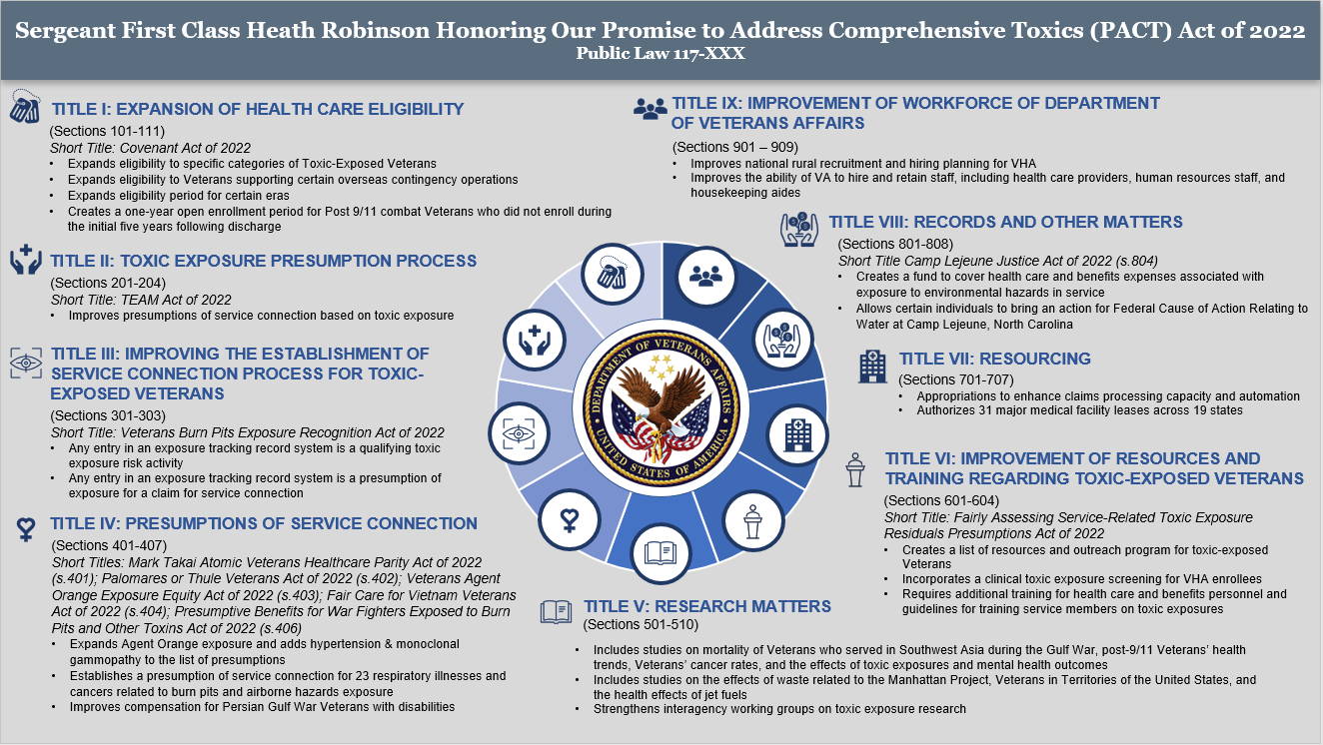
PACT Act (4 of 4)
Notes:
Reformatted

Slide 8
Military Exposures Research and PACT Act
Military exposures research and PACT Act are often used interchangeably. However, the field should understand key distinctions between the efforts.
VHA Military Exposures & PACT
ORD MERP
Funded infrastructure & research
PACT Act
Interagency Toxic Exposures Research Work Group

Slide 9
Military Exposures and Research Program

Slide 10



MERP – Building Nexus (1 of 3)
Why is MERP Needed?
The Military Exposures Research Program supports Veterans:
Every military conflict has had a characteristic exposure-related health concern
Lack of a nexus between exposure and health outcome(s) has been a barrier for Veterans to become eligible for VA care and disability benefits
Military exposure research was identified by Veterans Affairs Chief Research & Development Officer of the Office of Research & Development as a top cross-cutting clinical priority
Notes:
Military exposure research was identified by Veterans Affairs Chief Research & Development Officer of the Office of Research & Development as a top cross-cutting clinical priority

Slide 11
MERP – Building Nexus (2 of 3)
MISSION STATEMENT
The VA MERP seeks to advance military exposure assessments and to understand the effects of military exposures on Veterans’ health outcomes to inform care and policy.
MILITARY EXPOSURES
EXPOSURE ASSESSMENT
Refers to contact with toxic agents, singly or in combination, acquired through ingestion, respiratory, or skin contact routes during military service (Deployment, Occupation, or Garrison).
Refers to qualitative and/or quantitative identification and measurement of toxic agent(s) to which a Veteran was exposed during military service.
May include the development of new methods and/or assays that will directly or indirectly identify and measure an exposure to a toxic agent using biological materials or surrogates.

Slide 12
MERP – Building Nexus (3 of 3)
MERP PARTNERSHIPS
FEDERAL PARTNERSHIPS
VA PARTNERSHIPS
DoD
Army Public Health
Defense Health Agency
Millennium Cohort Group
DoD Biorepository
Individual Longitudinal Exposure Record (ILER)
Toxic Exposures Research Program (TERP)
National Institutes of Health
Environmental Health Sciences
Aging
Neurological Diseases
Nursing
Centers for Disease Control and Prevention (CDC)
Agency for Toxic Substances and Disease Registry (ATSDR)
Environmental Protection Agency (EPA)
ORD Services and Programs
MVP
CIPHER
VA SHIELD
Quality Enhancement Research Initiative (QUERI)
Health Outcomes Military Exposures (HOME)
War Related Injury Illness Study Centers (WRIISCs)
NON-FEDERAL AFFILIATES/ SMEs
COMMUNITY STAKEHOLDERS
Academia
National Academy of Science, Engineering, and Medicine (NASEM) (Emerging Science for Environmental Health Decisions)
Veterans with Toxic Exposures
Veteran Service Organizations (VSO)
Private Foundations – Toxic Exposures

Slide 13
MERP-SHIELD Biorepository Synergy
MERP
SHIELD
Future studies
Supports mission-relevant research
Encourages collection of biospecimens for future use
Reliable infrastructure for high-quality storage and distribution
Streamlined access to key resources for investigators
Propose projects which advance care & policy
Maximize value of existing resources and potential for scientific discovery
Transfer
Request use
Transfer
Distribution
VA SHIELD (Central Biospecimen and Data Repository) – https://research.va.gov/programs/shield/about.cfm

Slide 14
Actively Managed Portfolio (AMP) Approach (1 of 2)
What is an Actively Managed Portfolio Approach?
MERP is an AMP. The AMP structure is needed to ensure that the world-class research performed by VA is responsive to the healthcare challenges facing Veterans and generates improved real-world outcomes for them and their families.
To do this, the AMP initiative will:
Coordinate research activities within disease/condition areas to enable end-to-end research execution, translation into clinical practice, and to inform decision making.
Provide mechanisms to rapidly respond to emerging research needs.
Promote use of common data elements to enhance interoperability and interchange of data between stakeholders within a research area.

Slide 15
Actively Managed Portfolio Approach (2 of 2)
What is Unique about an Actively Managed Portfolio?
As an AMP, MERP will:
Administer an accelerated review process for priority research that allows for the peer-review of research during all 4 quarters of the year.
Utilize a matrixed organizational model that reduces duplicative research and increases collaboration.
Set Critical Research Priorities that will guide medium and long-term planning of the AMP.

Slide 16
Military Exposures Research Program
How does MERP work?
3 Pillars of MERP
Research
Communications / Education
Expanding Capacity through Partnerships
Post-Service Military Exposure Assessments
Chronic Health Outcomes from Military Exposure
Interplay of Military Exposures, disparities and co-morbidities
Leverage the three supporting Cores for seamless research
Communication, external-facing (website) to establish transparency, community of practice
Provide tools and resources to Military Exposure Stakeholders
Subject Matter Expertise
Technology
Data and Biospecimens

Slide 17
MERP Infrastructure (FY24)
Military Exposures Research Program (MERP) - Research Infrastructure
Enterprise-level core capabilities to support funded investigator studies needing exposure assessment, data/survey tools and analysis, biospecimen collection, storage and analysis.
Requests for Applications (RFA): RFAs were developed and released broadly to support key gap portfolio areas.
ORD Military Exposure Research Innovation Center(s) (MERICs) have been launched to support high impact, highly innovative key priority projects.
Capacity Building: Intra- and Inter-federal and academic partnership building are imperative to move military exposure assessment and health research forward efficiently and uniformly.
The Toxic Exposures Fund for ORD is $45 million. Roughly $25 million is available for RFA’s, Career Development Awards (CDA’s), and administrative funding.
Notes:
Military Exposures Research Program (MERP) - Research Infrastructure
Enterprise-level core capabilities to support funded investigator studies needing exposure assessment, data/survey tools and analysis, biospecimen collection, storage and analysis
Requests for Applications (RFA): RFAs were developed and released broadly to support key gap portfolio areas
ORD Military Exposure Research Innovation Center(s) (MERICs) have been launched to support high impact, highly innovative key priority projects
Capacity Building: Intra- and Inter-federal and academic partnership building are imperative to move military exposure assessment and health research forward efficiently and uniformly
The Toxic Exposures Fund for ORD is $45 million. Roughly $25 million is available for RFA’s, Career Development Awards (CDA’s), and administrative funding

Slide 18



MERP – Expert Resources
Cores
Administrative Core (Admin Core)
Data and Biorepository Commons Core (DBC Core)
Exposures Assessment Core
(EA Core)

Slide 19

MERP – Program Structure
COMMITTEES:
Please note these committees are still under development.
EXECUTIVE COMMITTEE
SCIENTIFIC STEERING COMMITTEE
The Executive Committee will be responsible for programmatic over-site.
The Scientific Steering Committee will be responsible for scientific over-site.

Slide 20
MERP Cores

Slide 21



MERP – Program Structure
What are MERP Cores?
Admin Core
DBC Core
EA Core
The Administrative Core will facilitate programmatic coordination and strategic planning among MERP stakeholders, including providing guidance to MERP investigators on MERP procedures and regulatory needs.
The mission of the Data and Biorepository Commons Core is to fill programmatic gaps with a focus on building and facilitating knowledge and access to trusted military-exposure data and biospecimens for military exposures research.
The mission of the Exposure Assessment Core is to build VA capacity in exposure assessment science and support MERP-funded investigators in the characterization of military exposures by providing subject matter expertise and technical assistance.

Slide 22
MERP Opportunities

Slide 23
MERP – Funding
Where to apply for MERP funding?
Service | Preapplication/LOI | Merit | CDA-1 | CDA-2
Biomedical Laboratory R&D (BLRD/BX) | Under development Spring 2024 – Not required Fall 2024 – required | BX-24-009 (MERP) | BX-24-021 (Veterans) | BX-24-023 BX-24-024 (Minority institutions) CX-24-023
Clinical Science R&D (CSRD/CX) | Under development Spring 2024 – Not required Fall 2024 – required | CX-24-009 (MERP) | CX-24-021 (Veterans) | BX-24-023 CX-24-023 CX-24-024 (Minority institutions)
Health Services R&D (HSRD/HX) | Summer 2024 Winter 2024 | HX-24-001 (Parent I01) | N/A | HX-24-009
Rehabilitation R&D (RRD/RX) | Summer 2024 Winter 2024 | RX-24-002 (Parent I01) | RX-22-016 | RX-22-017 RX-22-018 (Minority institutions)
Requests for Applications (RFA) and Program Announcements (va.gov) – https://vaww.research.va.gov/funding/rfa.cfm#blrd

Slide 24
MERP Summary
Who, What, How
Who is MERP helping?
The MERP program is managed by executive leaders and scientists who have a passion for, and real-world experience in, research into the medical issues that impact our Veteran population.
What is MERP?
MERP’s mission is to advance military exposure assessments and to understand the effects of military exposures on Veterans’ health outcomes to inform care and policy. The program will accomplish this by adding additional funding opportunities and guidance to VA researchers.
How is MERP going to help?
Working with researchers to fund and focus their research and to socialize their findings to improve the treatments, practices, and outcomes for our veterans.

Slide 25
MERP Contact

Slide 26
MERP – Contact Us
Contact
MERP Leadership
Rudolph (Rudy) Johnson, Ph.D. | MERP Director – rudolph.johnson3@va.gov
Shakeria (Shay) Cohen, Ph.D. | Scientific Program Officer – shakeria.cohen@va.gov
Admin Core | merpadmincore@va.gov
Deputy Chief Research and Development Officers:
Chris Bever, MD, MBA | Deputy CRADO – christopher.bever@va.gov
Wendy Tenhula, Ph.D. | Deputy CRADO – wendy.tenhula@va.gov
Grant Huang, Ph.D., MPH | Deputy CRADO – grant.huang@va.gov

Slide 27
Thank You

